Slide 1

How we built DataHoover
(A reporting toolkit that doesn’t suck)
Fran Barton
Family Health, Nottingham University Hospitals
Notes:
Apologies for the terrible joke
A project to deal with a problem that must be very common across NHS organisations, but this is my showcase to talk about the work we have done at NUH to develop our own solution.

Slide 2
DataHoover essentials
An R package originally designed and developed by Tom Smith at NUH, since May 2022
Designed to play nicely with other packages such as {SPCreporter} and {NHSRplotthedots}
Currently just used within Family Health (mainly maternity and neonatal) at our Trust
Notes:
Many of you will know Tom from the NHS-R Community

Slide 3

The situation
Why we built DataHoover

Slide 4

We needed to…
Respond quickly to customer requests for data
Produce aggregated (for example monthly) counts or rates for reporting
Produce patient-level or incident-level event lists for investigation and audit
Interact efficiently with a suite of SQL queries, and process the data returned
Manage connections to multiple databases

Slide 5
How DataHoover helps
Some examples

Slide 6
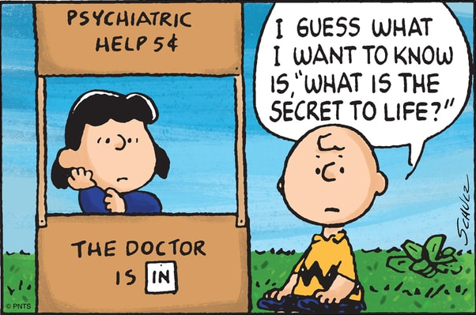
Customer questions
Statistical
Data analyst
“How many babies were born at our Trust in 2022?”

Slide 7
Question ↆ Event list ↆ Summary
DataHoover
SQL + YAML repository
* SQL query holds the logic
* YAML config manages DBs and dates
event_list <-
dh_get_data()
dh_get_data(
“M2”, “Total births”, “2022-01-01”, “2022-12-31”)
|>
dh_aggregate(“2022-01-01”, “2022-12-31”, “month”)
dh_aggregate(event_list, “2022-01-01”, “2022-12-31”, “month”)
dh_get_data()
dh_create_conns()
Notes:
So how does DataHoover help us to achieve these goals?

Slide 8
But there’s more…

Slide 9
Question ↆ Event list ↆ Summary ↆ Data bundle
DataHoover
SQL + YAML repository
* SQL query holds the logic
* YAML config manages DBs and dates
SQL + YAML repository
dh_build_report_dataset()
dh_get_data()
dh_aggregate()
dh_create_conns()
dh_calc_rates()
measure config
dh_build_report_dataset(measure_cfg, report_cfg, “2020-01-01”, “2022-12-31”, “month”)
report config
Notes:
Only pulls measures once – denominator data re-used, for example. Calculates rates.

Slide 10
The design
Some principles and limitations

Slide 11
Functional programming
Package code is very Tidyverse-oriented and makes good use of latest features in {dplyr} and {purrr} to adopt a functional programming approach – using lists and nested data within tibbles
Not always the preferred approach but makes it easier to read the code and get stuck in (IMHO)
Notes:
Some people prefer to mainly use base R in packages and reduce dependencies. I’m unapologetic about my dependence on the tidyverse (the truth is I’m terrible with base R)

Slide 12
Deliberate friction
DataHoover makes life easier…
…but it also makes things a little harder
It requires you to specify measure references and titles accurately, and provide start and end datetimes
Instead of making assumptions and using internal shortcuts, it will give you an error message
With great power…
Notes:
They say that with great power comes great responsibility, but here I would say with great power comes the great ability to make a royal mess of things. So DataHoover will try to check that you know what you are doing.

Slide 13
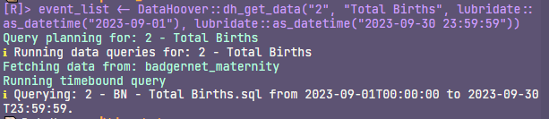
Verbosity
DataHoover is very chatty
It will tell you what you have asked for, and it will tell you what it is doing, and it will tell you what it has done

Slide 14

Assertiveness
DataHoover code contains a lot of assertions, using the {assertthat} package
These generate helpful and precise error messages if things aren’t right
When working with data, using a package that is in development, you want to be sure that the data pipeline is still doing what expect it to be doing
DataHoover can be quite demanding!
Notes:
These checks and balances serve the user but they are also helpful as a developer because they force you to be explicit about what inputs your function expects, and they raise the warning flag if something else comes through. It’s quite demanding!

Slide 15
The future
Sharing the code more widely

Slide 16
We’d like to
Improve (and update!) the package documentation so it’s really clear what it does and how to use it
Get feedback on the design structure of DH running alongside a sibling SQL + YAML repository
Promote the package so it might be more widely used within our Trust
Get approval for the code to be shared on a public repository such as GitHub
Notes:
Maternity is the testbed.
Apologies that the code is not yet available outside of our Trust

Slide 17
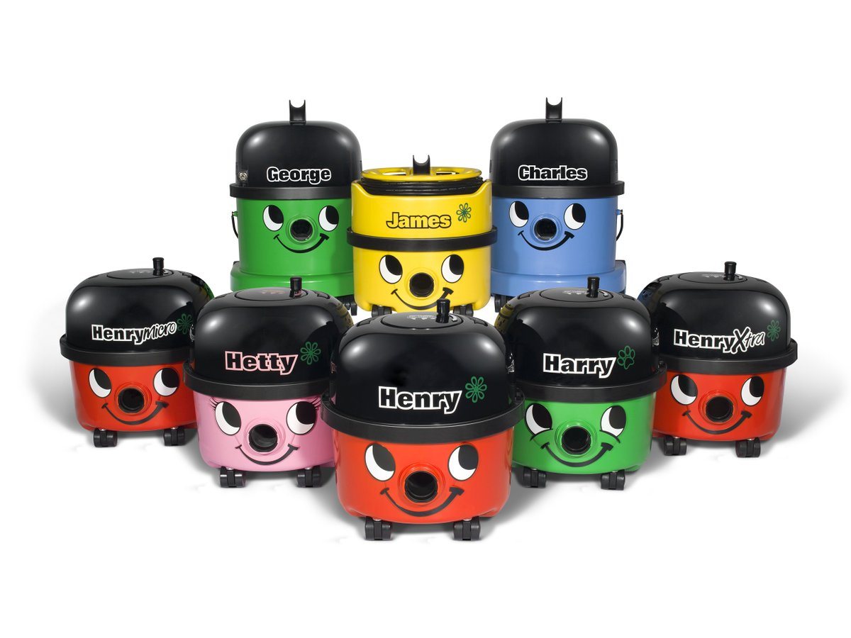
… so that people can make their own versions and submt enhancements

Slide 18
Summary
DataHoover gives us a quick, reliable and flexible way to answer customer queries with summary figures or detailed event lists
It handles a lot of the “dirty work”
DataHoover has some deliberate friction designed in in order to reduce the risk of user error
DataHoover is scalable to large reports: it can retrieve and aggregate many metrics into a single bundle

Slide 19

Acknowledgements
Desert image from cottonbro studio on pexels https://www.pexels.com/video/man-using-vacuum-cleaner-in-desert-6636788/
{SPCreporter} https://github.com/ThomUK/SPCreporter
{SPCreporter} presentation by Tom Smith 2022 https://youtu.be/fWYehE5U6Vs?t=2862

Slide 20


Thank you Do get in touch: francis.barton@nuh.nhs.uk ludictech@post.lurk.org

